Slide 1

MIS 776 Business Analytics
Presented by Michael J Lee, PhD

Slide 2

Clustering and Association Rules

Slide 3

Class Business
Reading for this week is Provost chapters 6 and 12.
The group sign-up is available, but only one group has self-organized. I’ll give you until Wednesday to wrap this up.
Once your group is structured, you should get started exploring possible data sets.
Let me know if you have any questions about what would make a good data set for this class.
Grading for assignment 2 is not yet complete. This should be ready by the end of this week.
The midterm exam will be coming up in a few weeks. I will post some announcements on Web Campus discussing the format and expectations for the exam.
For competition and research path students, I will provide some more details in emails to your groups.

Slide 4
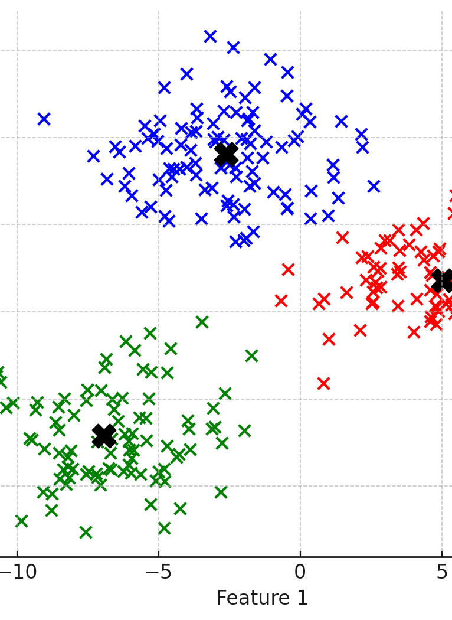
Session Themes
Unsupervised Learning – letting the data speak
If you don’t have training data, how do you get insights from the underlying data?
Clustering
Allowing the data to self-organize
Identify data elements with similarities
Association Rules
Exploring cooccurrence in data
What does event cooccurrence or object co-expression tell us?

Slide 5
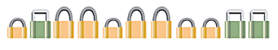
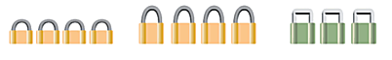
Basic Terminology
Cluster – a collection of objects that are similar to one another within the same cluster and are dissimilar to the objects in other clusters.

Slide 6
Motivating Questions
What are the characteristics of customers with good/bad ratings? Characteristics of those who are likely to buy or not buy?
How can I segment customers to improve marketing strategies?
How can I segment patients into groups with specific characteristics to better focus treatments and medical resources?
How can I discover the topics in my blog, Twitter, customer requests, etc?
How can I discover the patterns of intrusion/fraud events

Slide 7
Clustering Process
Initialization
Compute similarity between objects/clusters
Clustering based on similarity between objects/clusters
Stop if a stopping condition (threshold) is met or return to step 1
Notes:
Whats return to 1?

Slide 8
Taxonomy of Clustering
Distance-versus-density-versus-model based clustering and stopping criteria
Distance-based: reduce intra-cluster distance and/or increase inter-cluster distance
Density-based: increase density in a cluster
Model-based: cluster based on a certain mathematic model, e.g., a probability model or a neural network
Partitioning-versus-merging clustering
Partitioning: divide objects into clusters iteratively
Merging: merge clusters into larger clusters

Slide 9
Major Clustering Methods
SimpleK-means: distance-based partitioning
EM (Expectation Maximization): statistical modeling
Farthest-first: use Farthest-first traversal algorithm (Hochbaum & Shmoys, 1985) with distance-based partitioning method
Density-based: density-based
Cobweb: model-based conceptual clustering
Hierarchical Clusterer: hierarchical
Notes:
Remove IBM? Weka has a hierarchical clusterer also so should we just merge into weka?
Nearest neighbor is a weka classifier

Slide 10
Important Factors Affecting Distance-based Clustering
Selection of object attributes during pre-processing
Selection of clustering method (ex: K-Means)
Calculation of object similarity

Slide 11
Similarity/Dissimilarity
An object (e.g., a customer) has a list of variables (e.g., attributes of a customer such as age, spending, gender etc.)
When measuring similarity between objects we measure similarity between variables of objects.
We use distance function to measure dissimilarity between variables. Thus the further the distance between any two objects the more dissimilar they are.
Notes:
The larger the distance, the more dissimilar the objects.

Slide 12
Distance Matrix
A distance matrix can be created with objects as indexes and distance between objects as elements.
 | Boston | NY | DC | SF | LA
Boston | 0 | 200 | 450 | 3000 | 4000
NY | 200 | 0 | 250 | 2900 | 2700
DC | 450 | 250 | 0 | 2800 | 2500
SF | 3000 | 2900 | 2800 | 0 | 400
LA | 4000 | 2700 | 2500 | 400 | 0

Slide 13
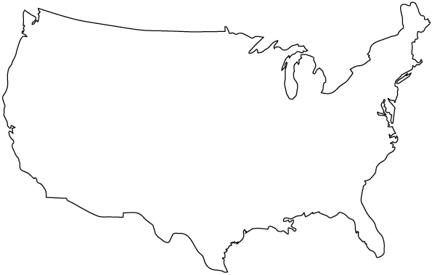
Distance Matrix
Boston
SF
NY
DC
LA

Slide 14
The K-Means Method
Randomly select k of the objects to be k cluster means
For each of the remaining objects:
Assign it to the cluster with the smallest distance from its cluster mean to the object
Recalculate the cluster mean
Calculate the within cluster sum of square-errors:
E = ∑ | object – object’s cluster mean|
all objects
Re-distribute objects if E can be reduced
Repeat 3 until E does not improve significantly over consecutive iterations
Notes:
Explain square error calculation?

Slide 15
K-Means Example (k=2): Initialization
Cluster 1
+
Boston
SF
+
NY
DC
Cluster 2
LA

Slide 16
K-Means Example: Assign Objects
Cluster 1
+
Boston
SF
+
NY
DC
Cluster 2
LA

Slide 17
K-Means Example: Assign Objects
Cluster 1
+
Boston
SF
+
NY
DC
Cluster 2
LA

Slide 18
K-Means Example: Assign Objects
Cluster 1
+
Boston
SF
NY
+
DC
Cluster 2
LA

Slide 19
K-Means Example: Redistribute Objects
Cluster 1
Boston
+
SF
NY
+
DC
LA
Cluster 2

Slide 20
K-Means Example: Redistribute Objects
Cluster 1
Boston
+
SF
NY
+
DC
LA
Cluster 2
E converges as no more object
redistribution can reduce E

Slide 21
Pros & Cons
Pros
Fast algorithm.
Cons
Difficulty in comparing quality of clusters.
Fixed number of clusters make it hard to predict its optimal performance.
Best to re-run analysis with different k values.

Slide 22
Why do we care?
Clusters are groups of similar entities
They may exhibit very different behavior
This may give us the ability to train and apply classification / regression models to separate clusters an increase overall accuracy

Slide 23
Demo
Clustering with K-Means

Slide 24
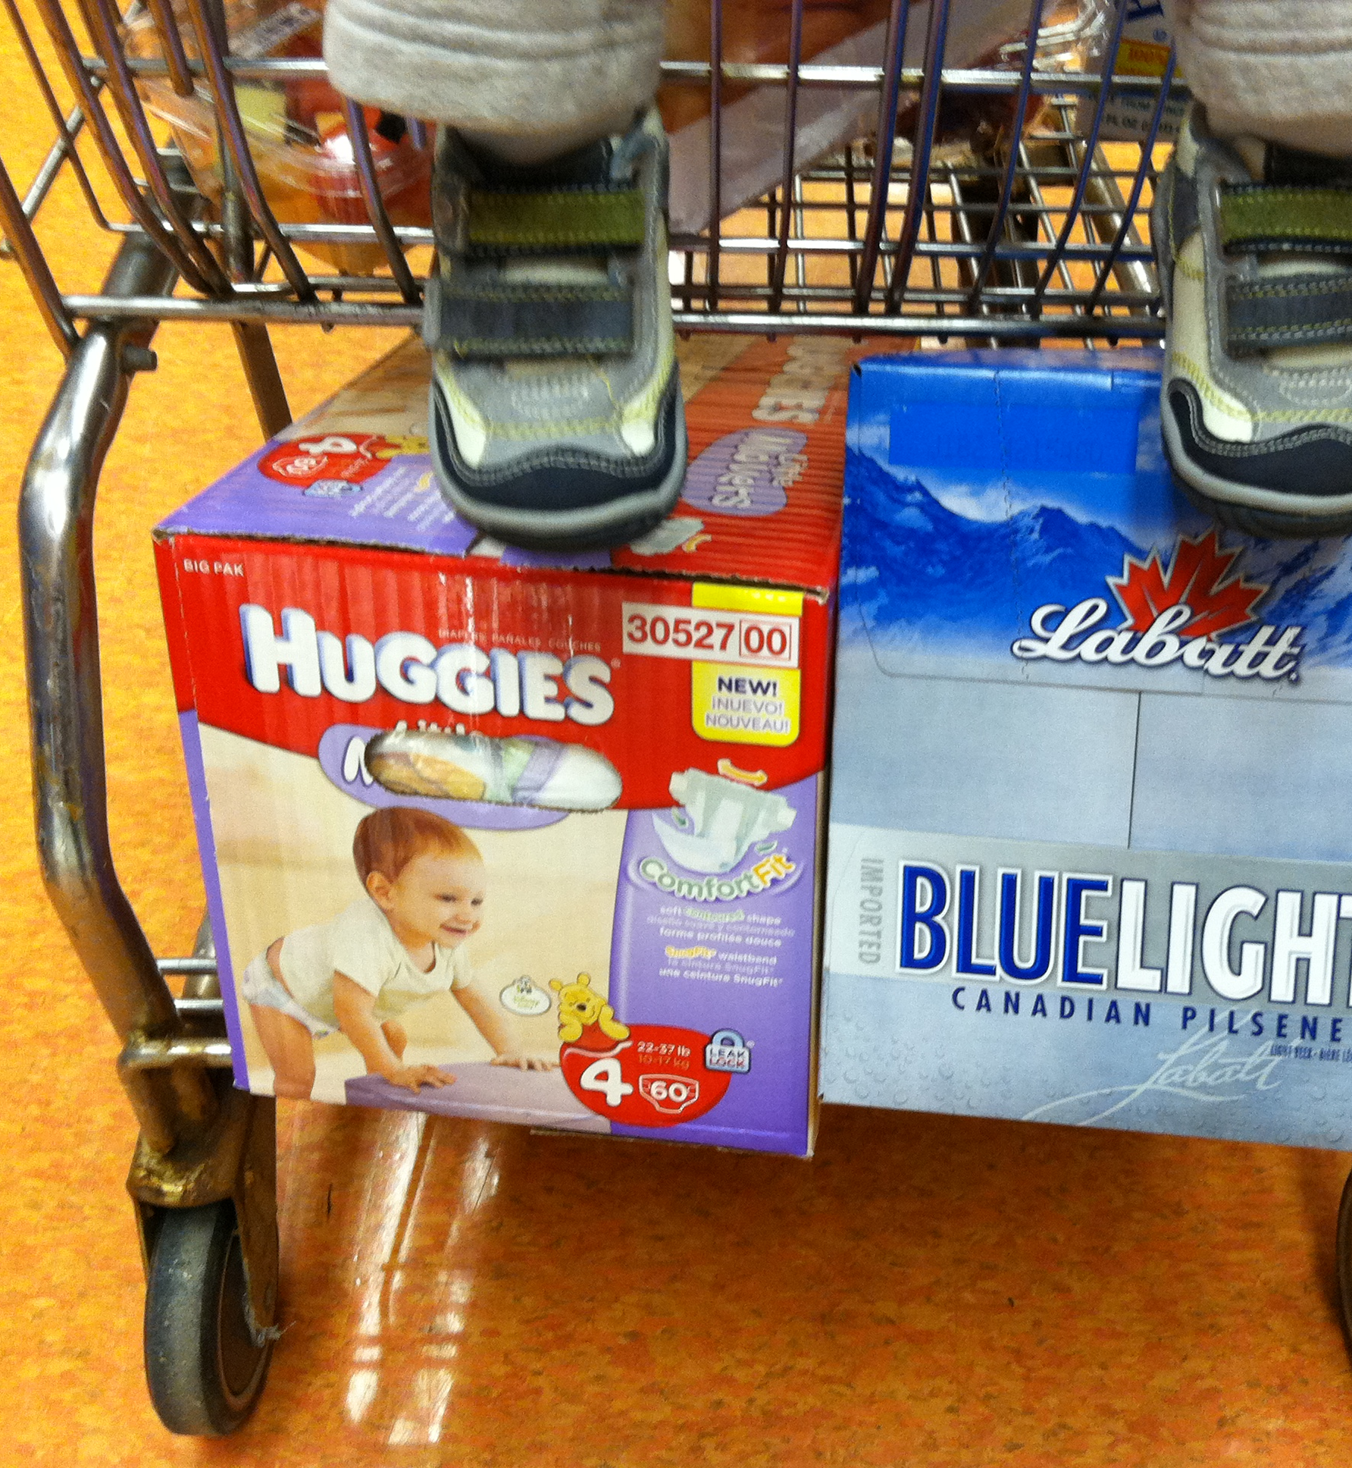
Association Rules
Identify things that happen together (co-occurrence)
Example – diapers and beer
Used to understand behavior and promote the behavior that you want.
Helps to identify behaviors that are
Complementary
Competing

Slide 25
Association
Under a given condition:
A set of objects →(implies) another set of objects
Retail items purchased together
Services subscribed by a customer
Web pages accessed by a user in a session
Courses taken by a student
Medications prescribed by a doctor
Genes expressed at the same level
Examples

Slide 26
Association
Customers who bought
A set of items →(tend to buy) another set of items
Retail items purchased together
Services subscribed by a customer
Web pages accessed by a user in a session
Courses taken by a student
Medications prescribed by a doctor
Genes expressed at the same level
Examples

Slide 27
Association
Customers who access (visit)
A set of pages →(tend to visit) another set of pages
Retail items purchased together
Services subscribed by a customer
Web pages accessed by a user in a session
Courses taken by a student
Medications prescribed by a doctor
Genes expressed at the same level
Examples

Slide 28
Association
From cancer patients’ tissue
A set of expressed genes→(imply) another set of genes are expressed
Retail items purchased together
Services subscribed by a customer
Web pages accessed by a user in a session
Courses taken by a student
Medications prescribed by a doctor
Genes expressed at the same level
Examples

Slide 29
Preliminary: Set Theory
A set is a collection of unique objects
E.g., set A = {3,5} and set B= {1,3,5}
Elements of a set are the objects belonging to it.
E.g., 3є{3,5}, 3є{1,3,5}, 3єA and 3єB
Set X is a subset of set Y if every element in X belongs to Y, denoted as X⊆ Y.
E.g., A⊆B or {3,5}⊆{1,3,5}

Slide 30
Preliminary: Set Theory
Two properties of set
Uniqueness of elements
E.g., set A = {3,5} and set B= {1,3,5}
Order of elements
E.g., {3,1,5} = {1,3,5}
Ordered sets are used in algorithms
to improve efficiency
Size of a set
The number of elements in a set.
E.g., size of {1,3,5} = 3

Slide 31
Association Rules
Given: A database of transactions
Example of transactions:
Customer’s visit to a grocery store
Online purchase at a virtual store such as Amazon

Slide 32
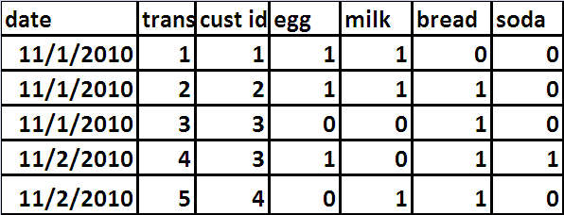
Example

Slide 33
Unit of Analysis
trans id | egg | milk | bread | soda
1 | 1 | 1 | 0 | 0
2 | 1 | 1 | 1 | 0
3 | 0 | 0 | 1 | 0
4 | 1 | 0 | 1 | 1
5 | 0 | 1 | 1 | 0
cust id | egg | milk | bread | soda
1 | 1 | 1 | 0 | 0
2 | 1 | 1 | 1 | 0
3 | 1 | 0 | 1 | 1
4 | 0 | 1 | 1 | 0
date | egg | milk | bread | soda
11/1/2010 | 1 | 1 | 1 | 0
11/2/2010 | 1 | 1 | 1 | 1
33

Slide 34
Association Rules
Find: patterns in the form of association rules
Association rules: correlate the presence (existence) of one set of items (X) with the presence (predict) of another set of items (Y), denoted as X → Y
Similar to conditional Probability P(Y|X)
Example: purchases of {eggs, milk} → (to predict) purchases of {bread}
How to measure correlations in association rules?

Slide 35
Definitions and First Metric
Itemset: A set of items.
E.g., {eggs, milk}
K-itemset: An itemset of size K.
First Metric: Support supp(X) = freq(X)/D
Support (s): The ratio of the # of transactions purchasing X to (÷) the total # of transactions in the DB. (also probability (s))

Slide 36
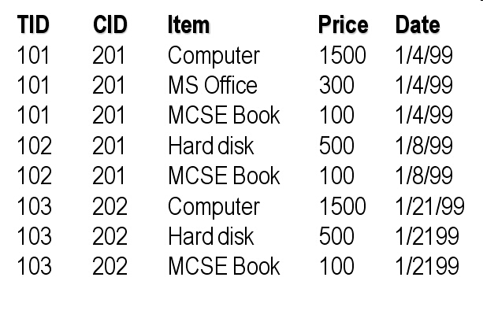
Example for Support

Slide 37
Example for Support
In this example (assume granularity at the transaction level):
The support of the 2-itemset {Computer, Hard disk} is 1/3=33.3%.
What is the support of 1-itemset {Computer}?

Slide 38
Support for Itemset
trans id | egg | milk | bread | soda | egg milk | egg bread | egg soda | milk bread | milk soda | bread soda | egg milk bread | egg milk soda | egg bread soda | milk bread soda | egg milk bread soda
1 | 1 | 1 | 0 | 0 | 1 | 0 | 0 | 0 | 0 | 0 | 0 | 0 | 0 | 0 | 0
2 | 1 | 1 | 1 | 0 | 1 | 1 | 0 | 1 | 0 | 0 | 1 | 0 | 0 | 0 | 0
3 | 0 | 0 | 1 | 0 | 0 | 0 | 0 | 0 | 0 | 0 | 0 | 0 | 0 | 0 | 0
4 | 1 | 0 | 1 | 1 | 0 | 1 | 1 | 0 | 0 | 1 | 0 | 0 | 1 | 0 | 0
5 | 0 | 1 | 1 | 0 | 0 | 0 | 0 | 1 | 0 | 0 | 0 | 0 | 0 | 0 | 0
Support | 0.6 | 0.6 | 0.8 | 0.2 | 0.4 | 0.4 | 0.2 | 0.4 | 0 | 0.2 | 0.2 | 0 | 0.2 | 0 | 0

Slide 39
2nd Metric - Confidence
If two itemsets X and Y co-exist in a transaction DB,
the association rule X→Y holds with:
Support (s): The ratio of the # of transactions purchasing both X and Y to (÷) the total # of transactions in the DB. (also probability (s))
2nd metric Confidence (c): The ratio of the support of transactions purchasing both X and Y to (÷) the support of transactions purchasing X only. Hence conf(X => Y) = supp(X U Y) /supp(X).
(also conditional probability of y given x)

Slide 40
Confidence for Association Rules
egg -> milk | conf(egg->milk) = supp(egg U milk)/supp(egg) | .4/.6 = .67
milk -> egg | conf(milk->egg) = supp(milk U egg)/supp(milk) | .4/.6 = .67
egg -> bread | conf(egg->bread) = supp(egg U bread)/supp(egg) | .4/.6 = .67
bread -> egg | conf(bread->egg) = supp(bread U egg)/supp(milk) | .4/.8 = .5
egg -> soda | conf(egg->soda) = supp(egg U soda)/supp(egg) | .2/.6 = .33
milk-> bread | conf(milk->bread) = supp(milk U bread)/supp(milk) | .4/.6 = .67
bread -> soda | conf(X->Y) = supp(bread U soda)/supp(bread) | .2/.8 = .25
egg -> milk, bread | conf(egg->milk,bread) = supp(egg U milk, bread) /supp(egg) | .2/.6 = .33
egg -> bread, soda | conf(egg->bread,soda) = supp(egg U bread,soda)/supp(egg) | .2/.6 = .33

Slide 41
Another Metric: LIFT
Lift of an association rule X → Y is defined as
Lift (X → Y)=conf(X → Y )/supp(Y)
Lift is the ratio of the probability that X and Y occur together to X and Y being independent.
If Lift (X → Y)=1 then X and Y are independent
If Lift (X → Y)< 1, then X and Y are negatively correlated
If Lift (X → Y)>1, then X and Y are positively correlated
Interesting association rules have lift greater than 1 (or possibly less than 1).

Slide 42
Association Rule Mining Algorithm
Association rule mining: find all association rules with support and confidence not less than user-specified values in the DB
For small problems, the process of mining association rules is not that complex.
How about a transaction database with 1 billion transactions and 1 million different items?
An efficient algorithm is needed!

Slide 43
Phases in Association Rule Mining
Find all large (or frequent) itemsets with support not less than a user-specified minimum support.
For each large itemset L, find all association rules in the form of a→(L-a) where a and (L-a) are non-empty subsets of L.
E.g. Find all association rules in the example with 60% or more support and 80% or more confidence.

Slide 44
Apriori Algorithm
An efficient algorithm to discover all large itemsets from a huge database with large number of items.
Developed by two researchers from IBM Almaden Research Lab.
Based on the Apriori property:
“Any subset of a large itemset must be large”

Slide 45
Apriori Algorithm
TID | Items
100 | 1,3,4,6
200 | 2,3,5,7
300 | 1,2,3,5,8
400 | 2,5,9,10
500 | 1,4
Minimum support =40%
Minimum confidence =70%
{2,3,5} is large → {2}, {3}, {5}, {2,3}, {2,5} and {3,5} must be large
Are these the only large itemsets?

Slide 46
Apriori Algorithm
Step 1: Scan DB one time to find all large 1-itemsets.
Step 2: Generate candidate K-itemsets from large (k-1)-itemsets.
Step 3: Find all large k-itemsets from candidate k-itemsets by scanning DB once
Go back to step 2 if candidate k-itemsets exist.
Stop when no more candidate itemsets can be generated.
Initiation
Iteration
Termination

Slide 47
Apriori Algorithm
TID | Items
100 | 1,3,4,6
200 | 2,3,5,7
300 | 1,2,3,5,8
400 | 2,5,9,10
500 | 1,4
Minimum support =40%
Minimum confidence =70%

Slide 48
Association Rule Mining
Tid Items
100 1, 3, 4, 6
200 2, 3, 5, 7
300 1, 2, 3, 5, 8
400 2, 5, 9, 10
500 1, 4
Minimum Support: 40%
Estimate Support
Large 1-itemset:
{1} support=3/5=60%
{2} support=3/5=60%
{3} support=3/5=60%
{4} support=2/5=40%
{5} support=3/5=60%

Slide 49
Association Rule Mining
Large 1-itemset:
{1} support=3/5=60%
{2} support=3/5=60%
{3} support=3/5=60%
{4} support=2/5=40%
{5} support=3/5=60%
Generate Itemset
Candidate 2-itemset:
{1, 2} {1, 3} {1, 4} {1, 5}
{2, 3} {2, 4} {2, 5}
{3, 4} {3, 5}
{4, 5}

Slide 50
Association Rule Mining
Candidate 2-itemset:
{1, 2} {1, 3} {1, 4} {1, 5}
{2, 3} {2, 4} {2, 5}
{3, 4} {3, 5}
{4, 5}
Estimate Support
Large 2-itemset:
{1, 3} support=2/5=40%
{1, 4} support=2/5=40%
{2, 3} support=2/5=40%
{2, 5} support=3/5=60%
{3, 5} support=2/5=40%

Slide 51
Association Rule Mining
Large 2-itemset:
{1, 3} support=2/5=40%
{1, 4} support=2/5=40%
{2, 3} support=2/5=40%
{2, 5} support=3/5=60%
{3, 5} support=2/5=40%
Generate Itemset
Candidate 3-itemset:
{1, 3, 4}
{2, 3, 5}

Slide 52
Association Rule Mining
Candidate 3-itemset:
{1, 3, 4}
{2, 3, 5}
Estimate Support
Large 3-itemset:
{2, 3, 5} support=2/5=40%
Generate Itemset
Candidate 4-itemset:
No candidate 4-itemset. Stop.

Slide 53
Demo
Mining Association Rules

Slide 54

Assignments for this week
Stay current on the reading
Provost Chapters 6 & 12
Discussion 5
Reminder: Initial post due on Wednesday @ 11:59 PM
Follow-up posts due on Sunday @ 11:59 PM
Assignment 3: Clustering and Model Improvement
Finish your group sign-up
Anyone not in a group by Wednesday will be assigned by me.

Slide 55

Questions?
Contact me via Web Campus
Or email at:
michael.j.lee@unlv.edu

